Slide 1
Project Name : P935 Insurance Analytics
Presented by -Group - 7
Ankit Kumar Gupta
Himani Srivastava
E Hima Priya

Slide 2
Overview of Insurance Analytics
Insurance analytics involves using BI tools and data modelling to help insurance companies understand customer behavior, policy trends, and business performance. This project focused on building KPI dashboards for stakeholders to assess sales, claims, renewals, meetings, and target vs achievement at both individual and branch levels.
What It’s Used For: To track branch-level performance across various insurance products including new, cross-sell, and renewal policies.
How It Works: We collected policy, meeting, opportunity, and invoice data and created interactive dashboards using Excel, Tableau, Power BI, and SQL to analyze key KPIs like policy count, customer segmentation, claim status, premium growth, and payment behavior.
Key Characteristics:
Uses real operational insurance data.
Covers both new and renewal business.
Tracks performance by region, account executive, and branch.
Identifies conversion patterns from opportunity to policy.
Focuses on targets, achievement %, meetings, and claims.

Slide 3
Tools Used & Project Workflow
Excel Dashboard: Initial dashboard with pivot charts and KPI summaries.
SQL: Structured data loading, cleaning, and transformation.
Power BI / Tableau: Developed dynamic visual dashboards with slicers and drill-downs.
Workflow Steps:
Data Extraction from raw Excel sheets
SQL Integration (Insurance DB schema)
Building KPIs & data model
Dashboard creation
QA & final presentation

Slide 4
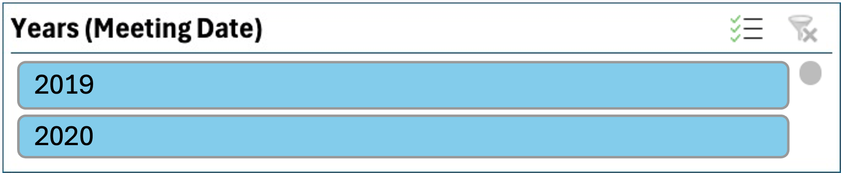
Branch Dashboard Overview & Key Insights
The Branch Dashboard provides a performance snapshot for each branch across three main business types: Cross Sell, New, and Renewal. It allows the Corporate Team to monitor targets, achievements, invoicing, and conversion metrics at both branch and individual account executive level. The dashboard is essential for strategic decision-making, ensuring alignment between sales efforts and business goals.
Number of Invoices by Account Executive
Account Executives like Vinay, Vikas Shah, and Kiran have contributed invoices across multiple categories (New, Renewal, Cross Sell).
Vinay and Kiran generated the highest volume of invoices overall.
Balanced invoicing across categories is seen from AE like Mark and Himanshu Kumar.
Yearly Meeting Count
The slicer indicates meetings from 2019 and 2020.
Abhisar Sharma conducted the most meetings (7) followed by Assistant Shivani and Kiran.
AEs with fewer meetings like Rajkumar or Mark might need further engagement push.

Slide 5
Key Insights & Patterns
Cross sell
Cross Sell – Target, Achieve (Placed & Invoice)
Target: ₹10.67M | Placed: ₹0.24M | Invoiced: ₹0.03M
Placed Achievement: 2.24% | Invoiced Achievement: 0.64%
Insight: Cross-sell performance is significantly below target, highlighting a major gap in execution.
New Business – Target, Achieve (Placed & Invoice)
Target: ₹3.10M | Placed: ₹0.03M | Invoiced: ₹0.03M
Placed Achievement: 0.87% | Invoiced Achievement: 0.23%
Insight: Very low achievement in new business; suggests lead conversion issues or lack of follow-ups.
Renewal – Target, Achieve (Placed & Invoice)
Target: ₹17.01M | Placed: ₹1.34M | Invoiced: ₹0.39M
Placed Achievement: 7.87% | Invoiced Achievement: 3.74%
Insight: Renewal business is performing better than other segments, but still far from full target.
Cross sell
Renewal

Slide 6
Key Insights & Patterns
Stage by Revenue
Opportunities are mainly stuck in early stages:
"Qualify Opportunity" and "Propose Solution" dominate.
Very few are in the "Negotiate" or closure stage.
Insight: Indicates slow movement of pipeline, requiring action to push deals ahead.
Number of Meetings by Account Executive
Gilbert leads with the highest number of invoices, focused entirely on Renewals.
Ketan Jain and Juli show balanced contributions across Cross Sell, New, and Renewal.
Animesh Rawat stands out in Cross Sell with 20 invoices.
Some AEs like Mark and Abhinav Shivam have low invoicing activity, indicating room for improvement.

Slide 7
Key Insights & Patterns
Top Open Opportunities
EL-Group Medclaim and DB-Mega Policy are the top open deals, each valued at ₹400,000.
CVP GMC follows with an opportunity size of ₹350,000.
Four other high-value deals (DS-Employees GMC, FM-Group Medclaim, BE-Mega Policy, and DB-Terrorism Policy) are each worth ₹300,000.
Closing even a few of these can significantly impact revenue achievement.
Product-Wise Opportunity Distribution – Overview
Employee Benefits leads with the highest opportunity count (15 opportunities).
Fire is the second most focused category with 13 opportunities.
Marine and Engineering follow with 7 and 6 opportunities, respectively.
Terrorism, Miscellaneous, and Liability have minimal focus, with 1–5 opportunities.

Slide 8
Policy Dashboard - Key Insights
Age Bucket Wise Count
Majority of policies held by customers aged 46–60 (1,807).
18–25 age group has the lowest policy count (572), showing opportunity for youth engagement.
Gender Wise Policy Count
Gender split is fairly even:
Male: 34%, Female: 34%, Other: 32%
Reflects diverse customer base and inclusivity.

Slide 9
Key Insights & Patterns
Policy Type Wise Count
Most popular: Health (1,316), followed by Property (1,236) and Life (1,234).
Auto insurance has the lowest count (1,214), suggesting potential to grow in that segment.
Claim Status Distribution
Claims are evenly split among Approved (34%), Denied (33%), and Pending (33%).
High pending and denied rates highlight a need for better claim processing.

Slide 10
Some Key Business Suggestions for Insurance Analytics
For Branch Performance & Sales Execution
Set Realistic Targets by Category & Executive Align targets with past performance, product potential, and branch capability to improve achievement rates and reduce over/underperformance.
Strengthen Follow-Up on Open Opportunities A large number of high-value opportunities remain in early stages. Prioritize timely follow-ups and closure strategies to boost conversion rates.
Improve Placement vs Meeting Effectiveness Track not just the number of meetings, but their outcomes. Use conversion ratios to coach AEs on quality over quantity.
Balance AE Portfolio Across Business Types Encourage account executives to diversify efforts across New, Cross Sell, and Renewal to reduce risk from single-line dependency.

Slide 11
Some Key Business Suggestions for Insurance Analytics
For Policy & Customer Insights
Focus on Young and Untapped Age Segments Engagement is low in the 18–25 age bracket. Promote relevant products (e.g., term insurance, health plans) to attract younger customers.
Enhance Claim Approval Rate & Reduce Pending Volume One-third of claims remain pending. Improve claim turnaround time and communication for better customer trust.
Boost Auto & Miscellaneous Policy Adoption Product distribution shows weaker adoption in Auto and Misc categories. Target marketing and awareness campaigns to grow these lines.
Resolve Payment Failures Proactively With 50% of payments marked as failed, strengthen payment collection workflows, follow-up reminders, and digital payment methods.

Slide 12
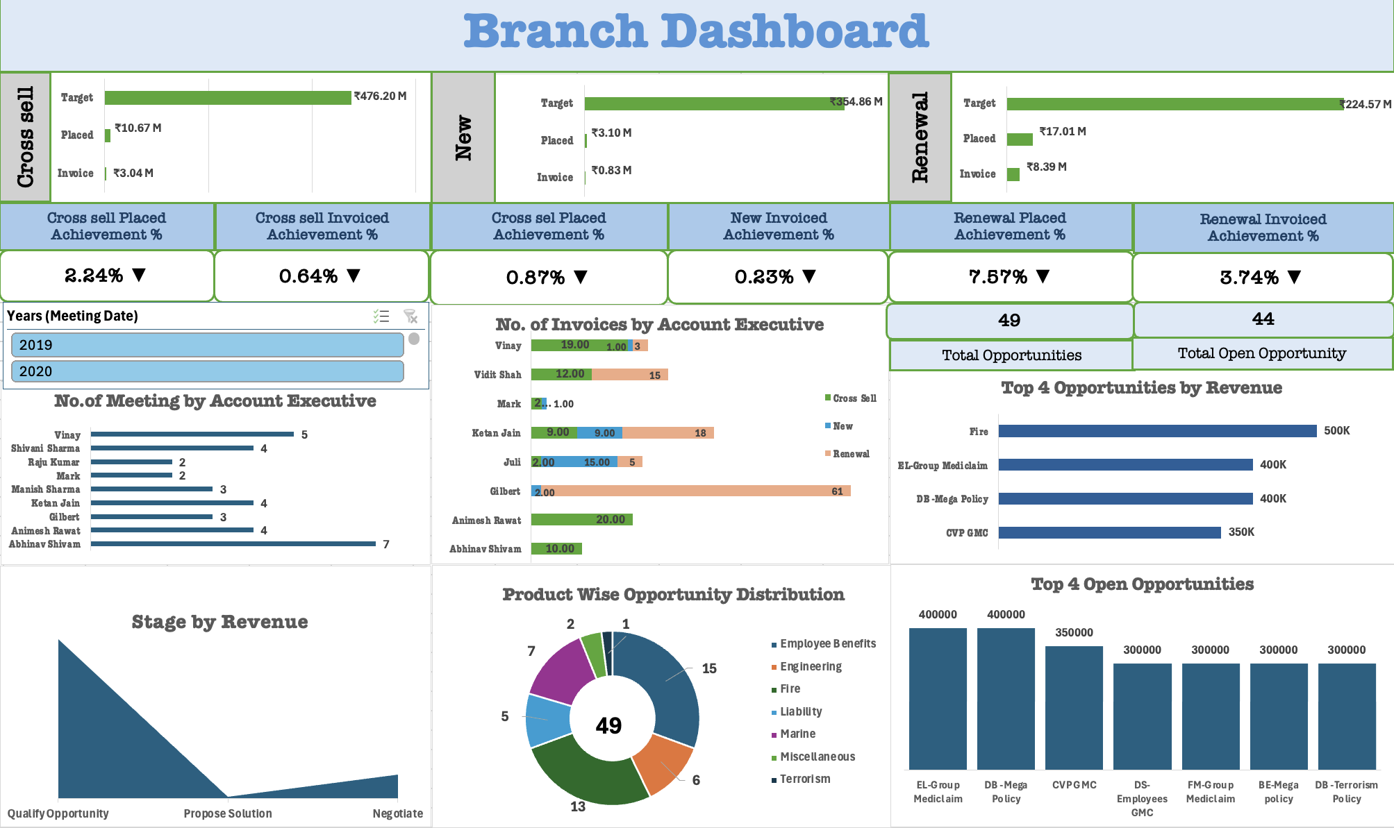
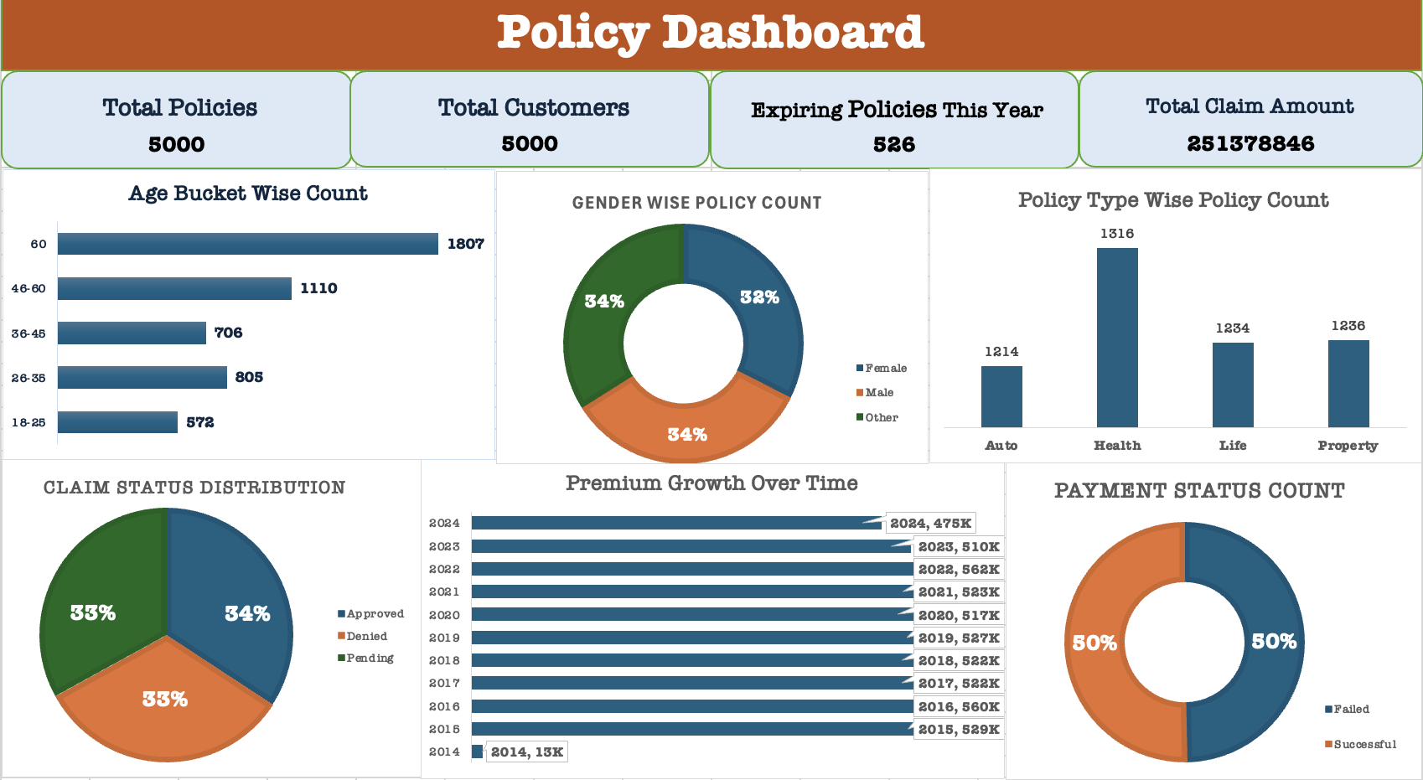
Dashboards
Excel Dashboards

Slide 13
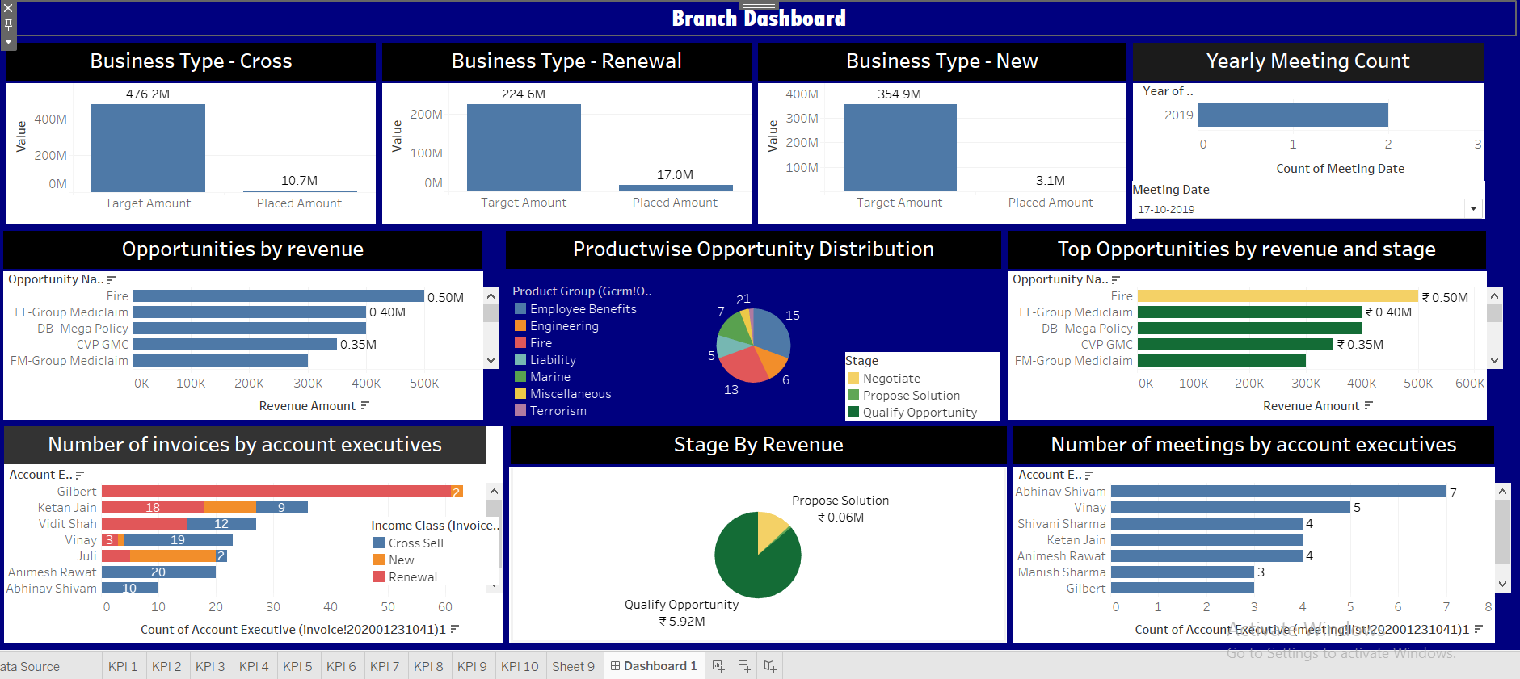
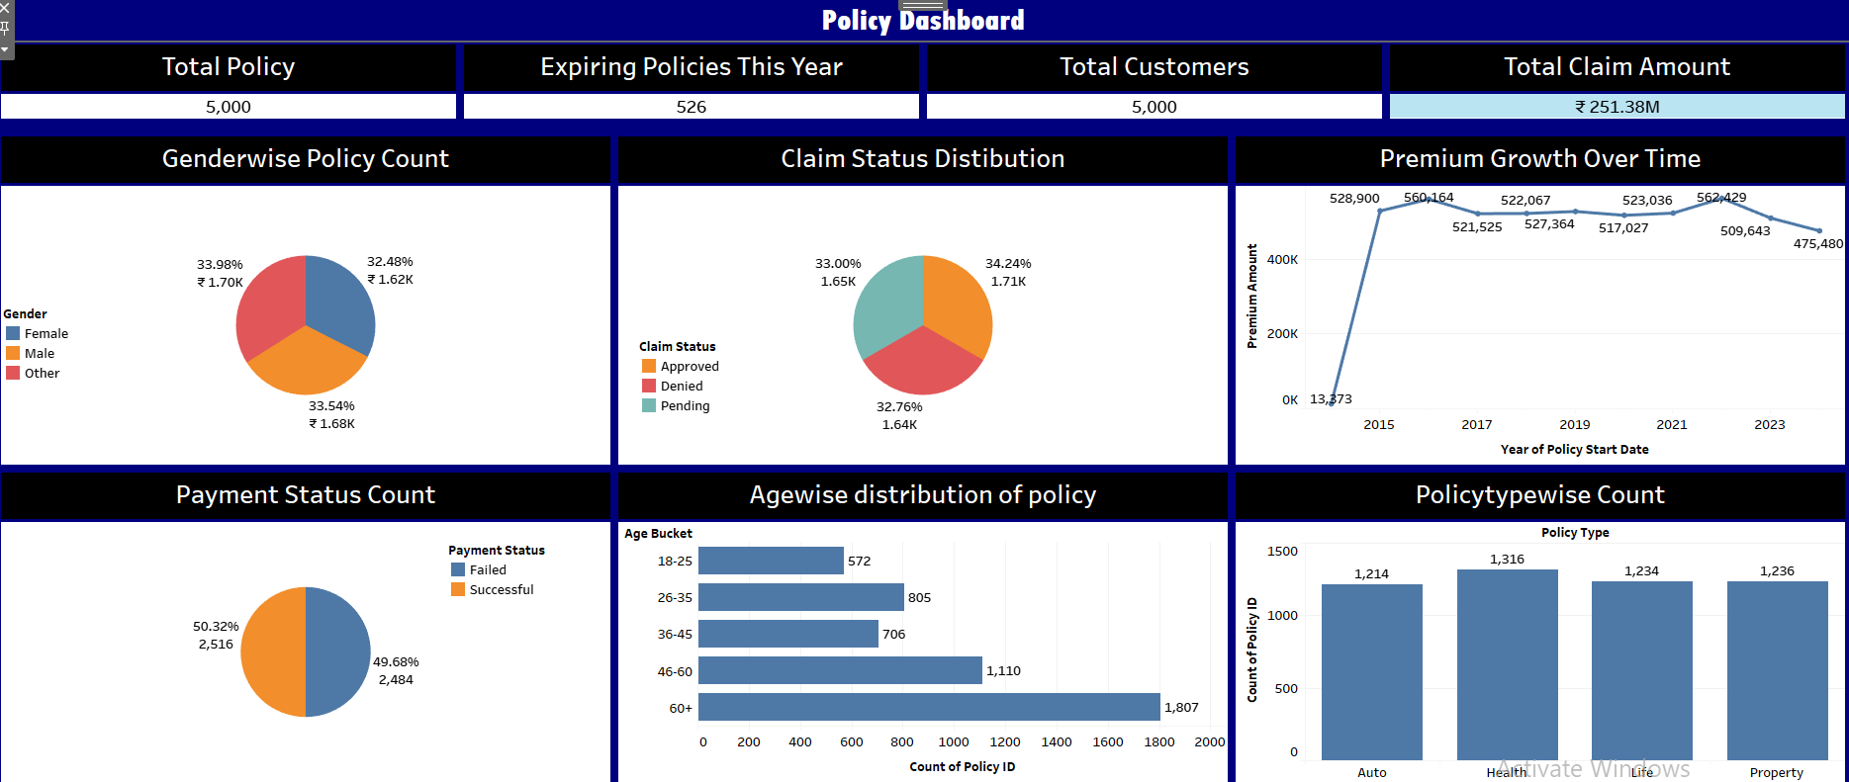
Dashboards
Tableau Dashboards

Slide 14
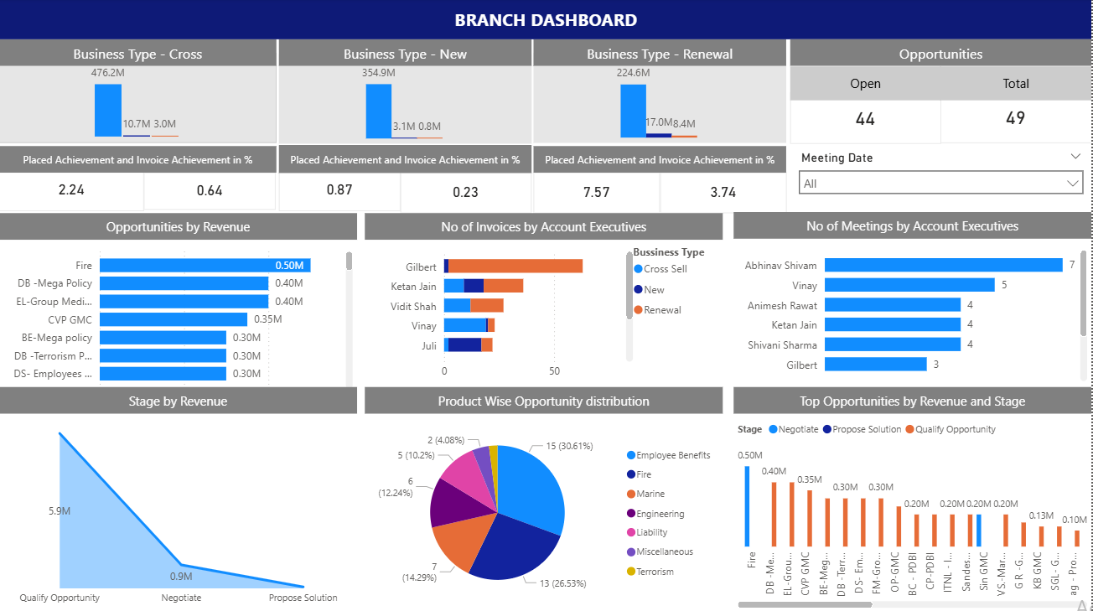
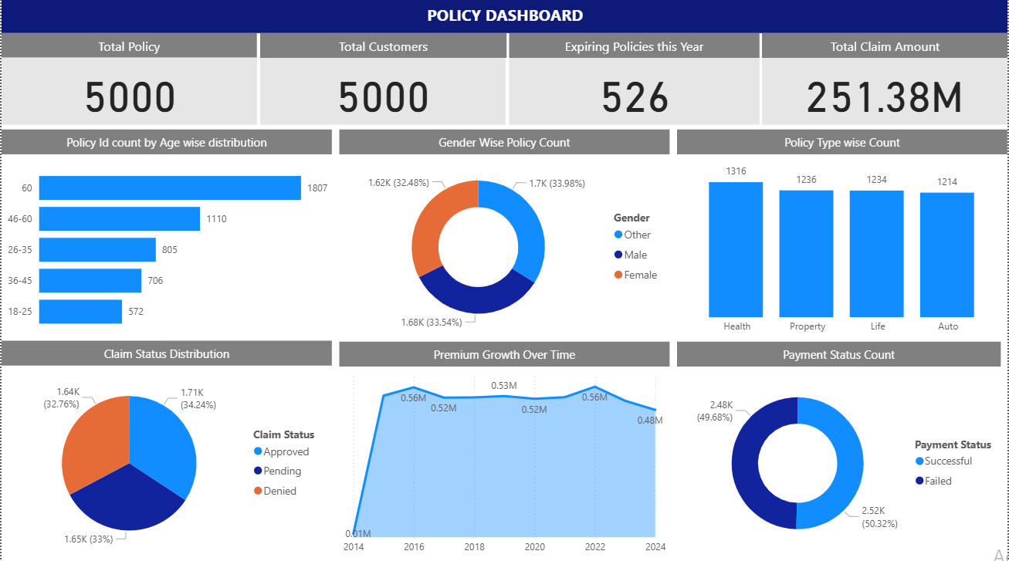
Dashboards
PowerBI Dashboards

Slide 15
Project Conclusion
The Insurance Analytics project delivered a comprehensive view of both sales performance at the branch level and customer-policy behavior at the portfolio level. Using dashboards in Excel, Power BI, and Tableau, we successfully transformed raw insurance data into actionable insights.
The Branch Dashboard highlighted key gaps in target achievement, especially in new and cross-sell business, while identifying top-performing executives and high-value open opportunities for strategic follow-up.
The Policy Dashboard offered insights into customer segmentation by age, gender, and policy type, with visibility into claims, premium growth, and payment status, helping monitor operational and financial KPIs.
Critical business issues such as payment failures, pending claims, and low opportunity conversion were clearly identified, allowing for focused corrective actions.
Overall, the dashboards empower stakeholders with data-driven visibility to improve sales execution, customer service, and portfolio performance, supporting smarter decisions and long-term growth.

Slide 16

THANK YOU..

